Slide 1
Voyage vista:
Illustrating uber insights
Expeditionary analysis

Slide 2
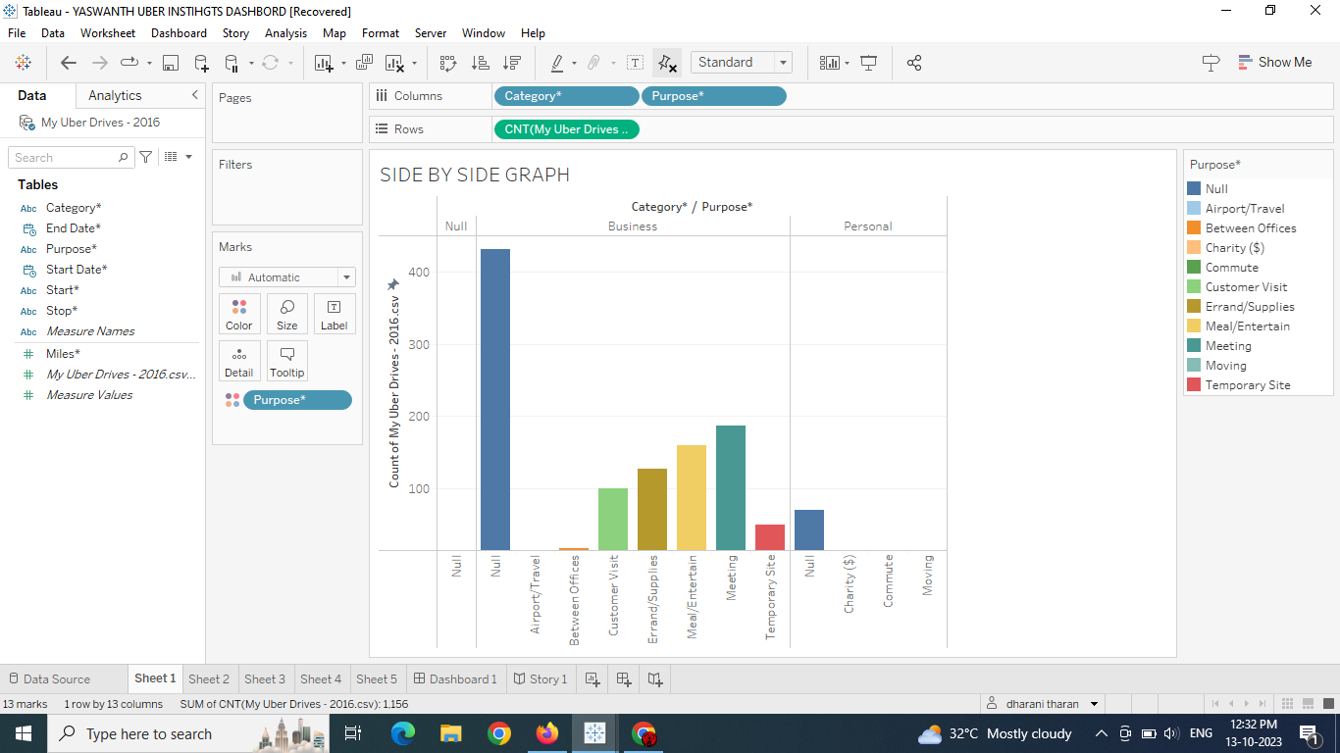
count of the uber drivers

Slide 3
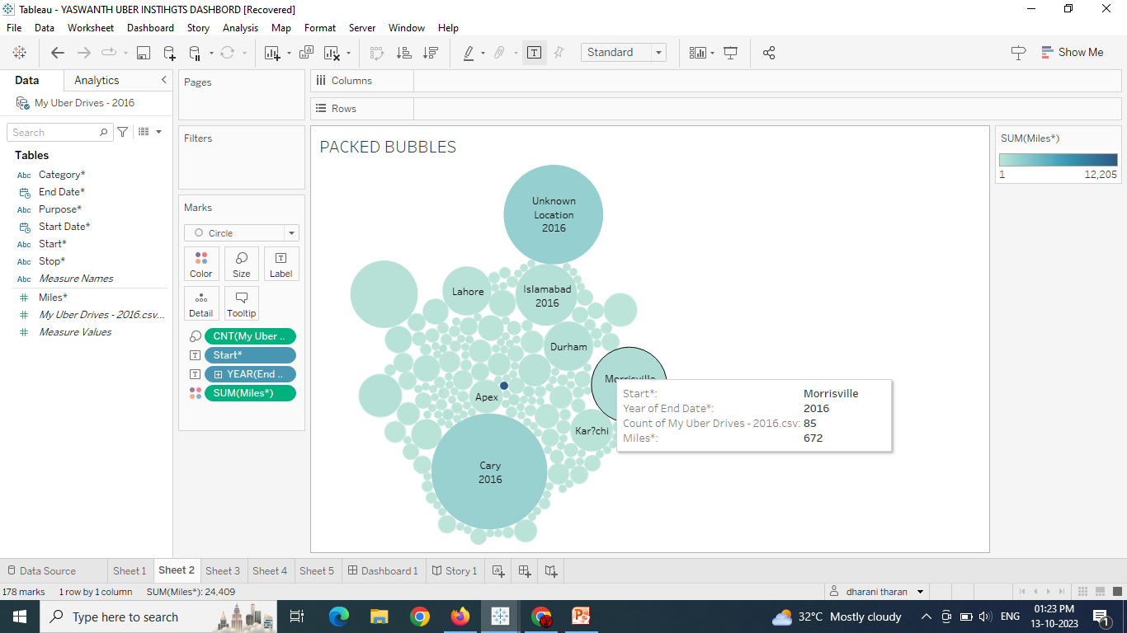
locations

Slide 4
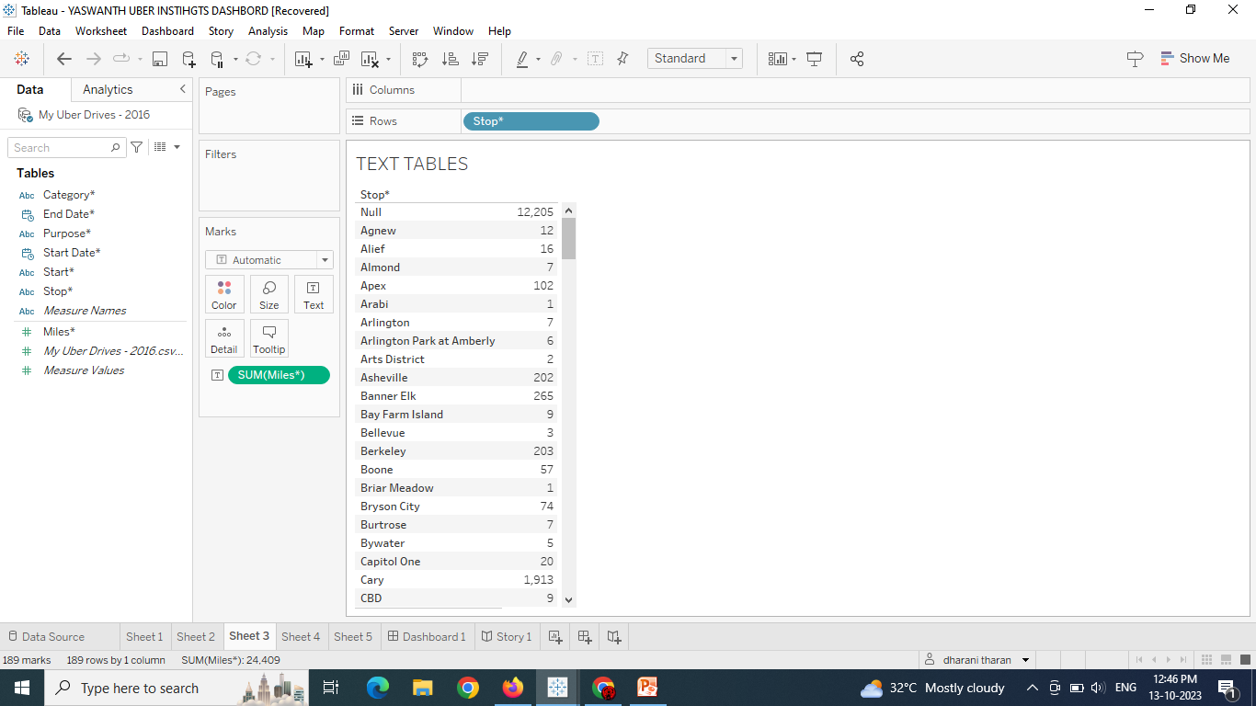
Distance and destinations

Slide 5
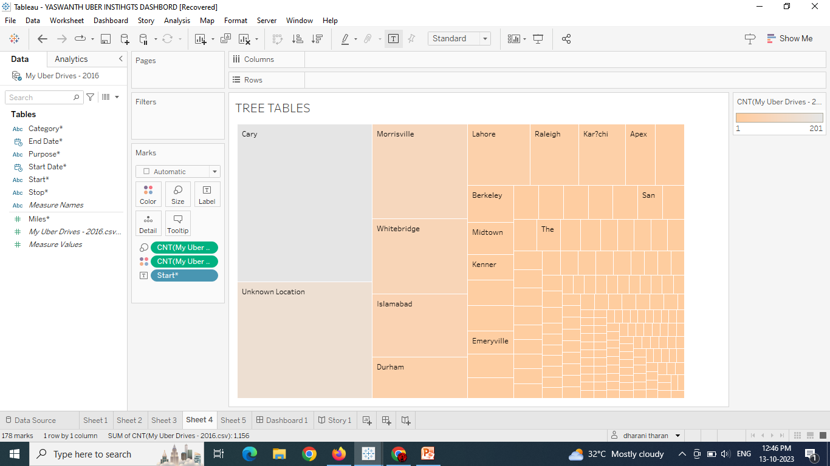
Locations in tree table

Slide 6
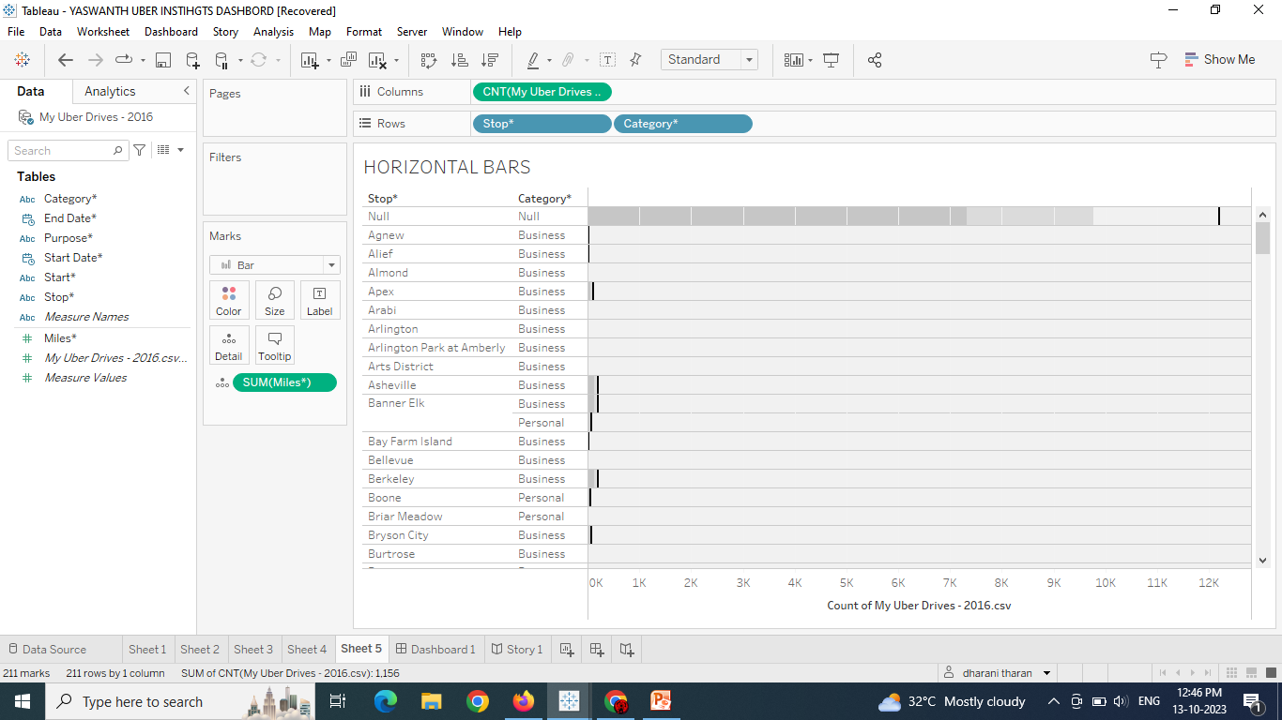
Economical status

Slide 7
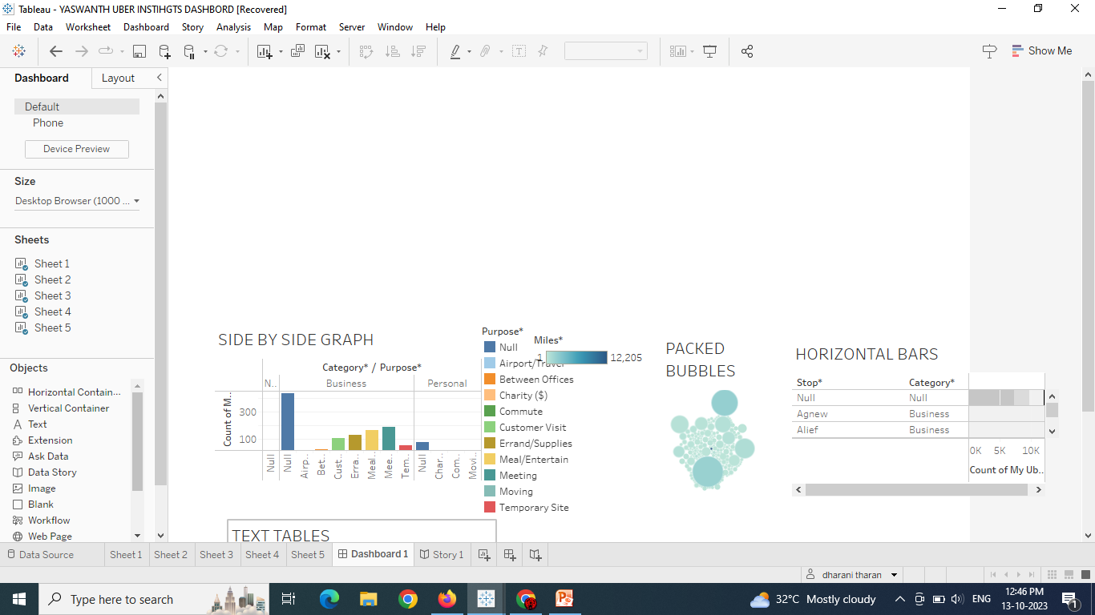
Dash board

Slide 8
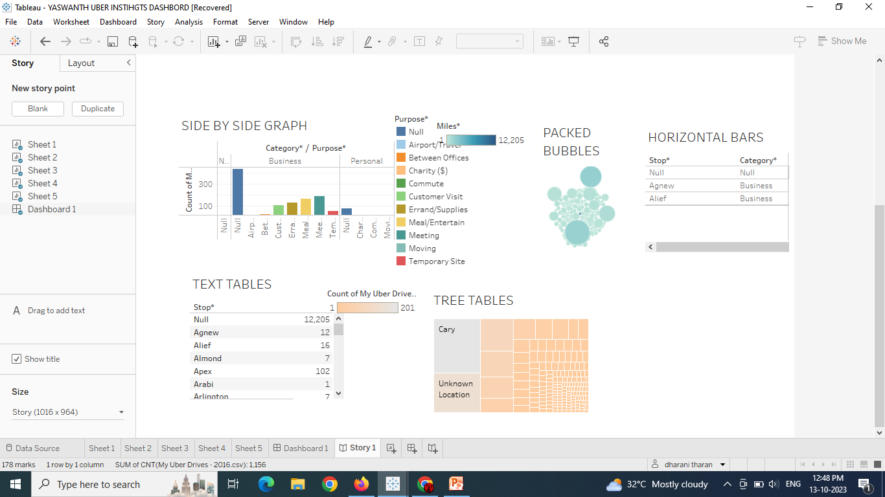
story

